Slide 1
Research and Startup
Prof. Dr. Dirk Riehle
Friedrich-Alexander University Erlangen-Nürnberg
COSS D02
Licensed under CC BY 4.0 International
Notes:
It is Friedrich-Alexander University Erlangen-Nürnberg – FAU, in short.
Corporate identity wants us to say “Friedrich-Alexander University”.

Slide 2
Agenda
Research vs. startup
Project management
Lead programming
Open source strategy
Getting users
Getting contributions

Slide 3
1. Research vs. Startup

Slide 4
Goal Conflict
Research
  Desired output
    Research papers
    A dissertation
Startup
  Desired output
    Software product
    A startup

Slide 5
Resulting Time Allocation
100%
Research / startup
time spent ratio
time

Slide 6
2. Project Management

Slide 7
The Solo Founder Model
EM
PM
Roles
Posts
RA
P
P = Professor
RA = Researcher (often Ph.D. student) [1]
MS = Master student (sometimes Bachelor student)
MS1
MS2
...
MSn
[1] The researcher (research project) acts as the lead engineer (startup)

Slide 8
The Peer Group Model
MS1
MS2
...
MSn
P = Professor
RA = Researcher (often Ph.D. student)
MS = Master student (sometimes Bachelor student)
P
RA1
MS1
RA2
RA3
MS1
MS2
MS2
...
...
MSn
MSn

Slide 9
Project Recruiting
Researchers
  Recruited by professor
  Funded through research grants, self-funded
Masters students
  Recruited by researchers with support by professor
  Funded through research grants, self-funded

Slide 10
Project End
Research project finished
Startup created (or failed)

Slide 11
3. Lead Engineering

Slide 12
Lead Engineer [1]
A lead engineer
  Is an engineer who leads the development of a component / system
    In case of solo founder: The system
    In case of peer group: A key component
  W.r.t. the component, is responsible for maintaining
    Product vision and getting the features done
    Architectural integrity and code quality
  Manages other people as they contribute to the component
    In the beginning, they write most of the code themselves
    Later, they review and integrate code more than they write
Contributors are
  Students at the university (e.g. Master’s students)
  Later: Open source volunteers
MS1
RA
MS2
MS3

Slide 13
Role Name Equivalencies
Context | Lead role | Helper role
University | Ph.D. student | Master student
Research project | Graduate researcher | Research assistant
Startup project | Lead engineer | Student engineer
Open source project | Committer | Contributor
Company | Co-founder | Early employee

Slide 14
Lead Engineer / Student Engineer Collaboration
Lead engineer defines feature
  If necessary breaks it down into tasks
  Assigns tasks or waits for volunteers
With student engineer, discusses design
  Helps break down work into tasks / increments
  Ideally, discussion is public (in open source anyway)
In multiple increments, reviews and merges code
  Student engineer provides sufficiently small commit
  Lead programmer reviews, comments, integrates
Until feature is fully implemented

Slide 15
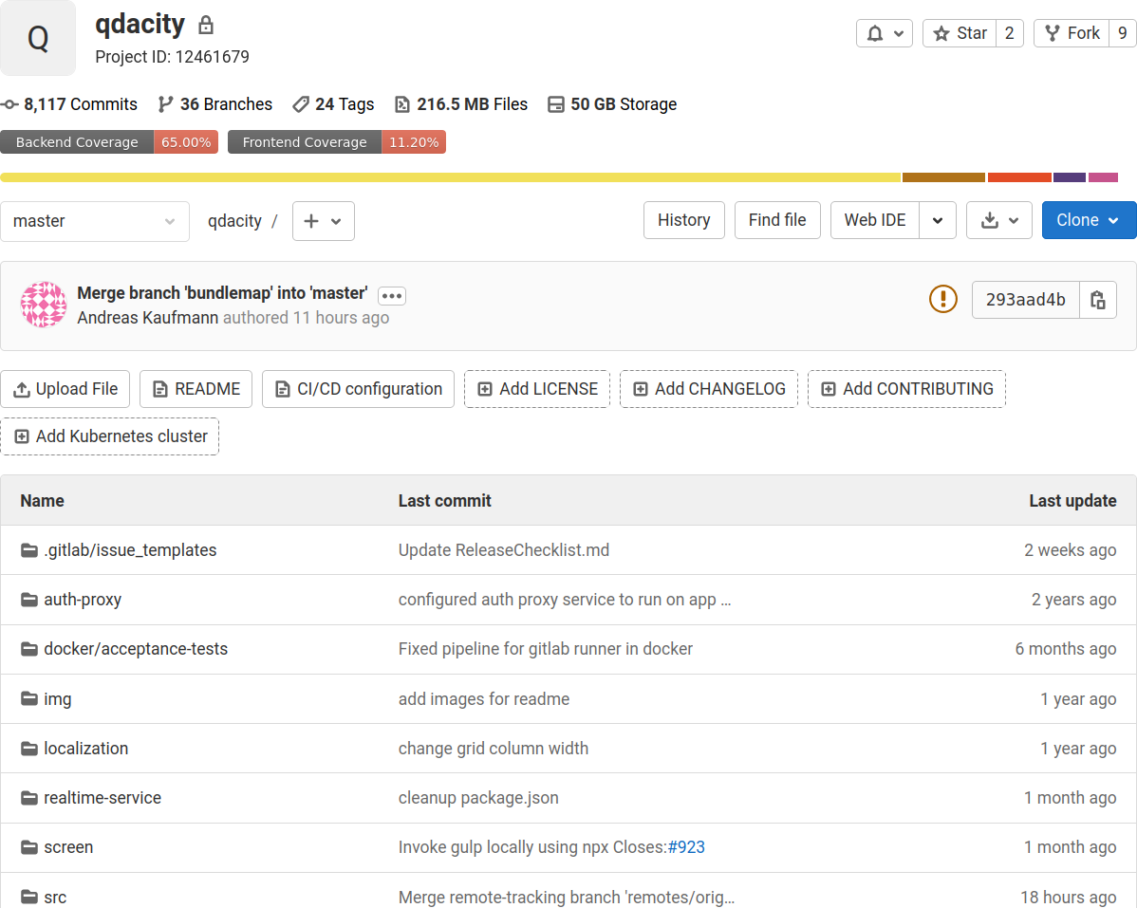
Central Project

Slide 16
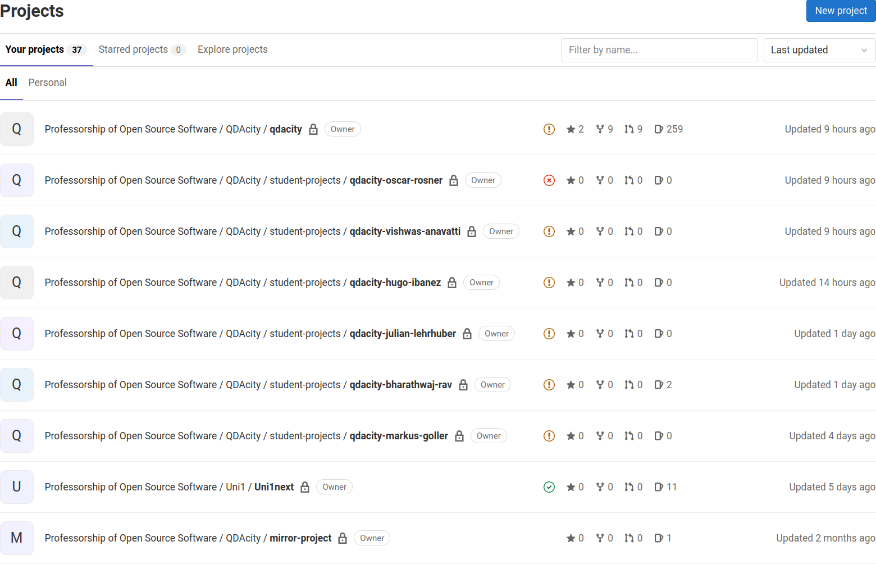
Distributed Development

Slide 17
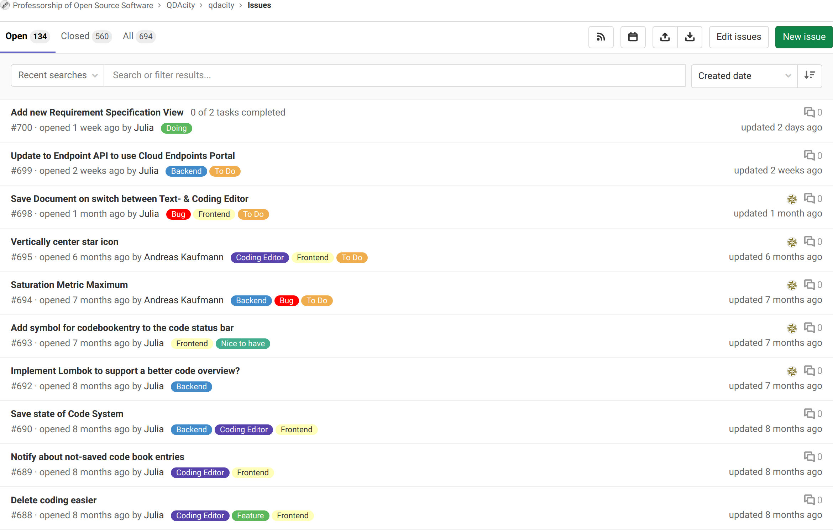
Issue Management

Slide 18
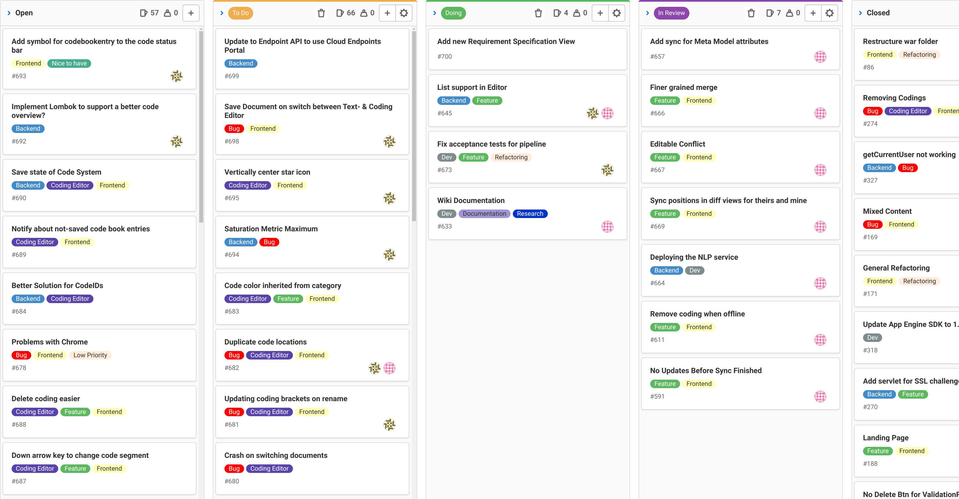
Kanban Board

Slide 19
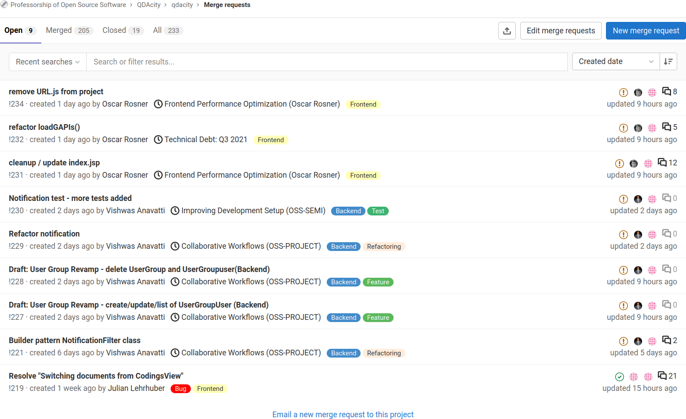
Merge Request Backlog

Slide 20
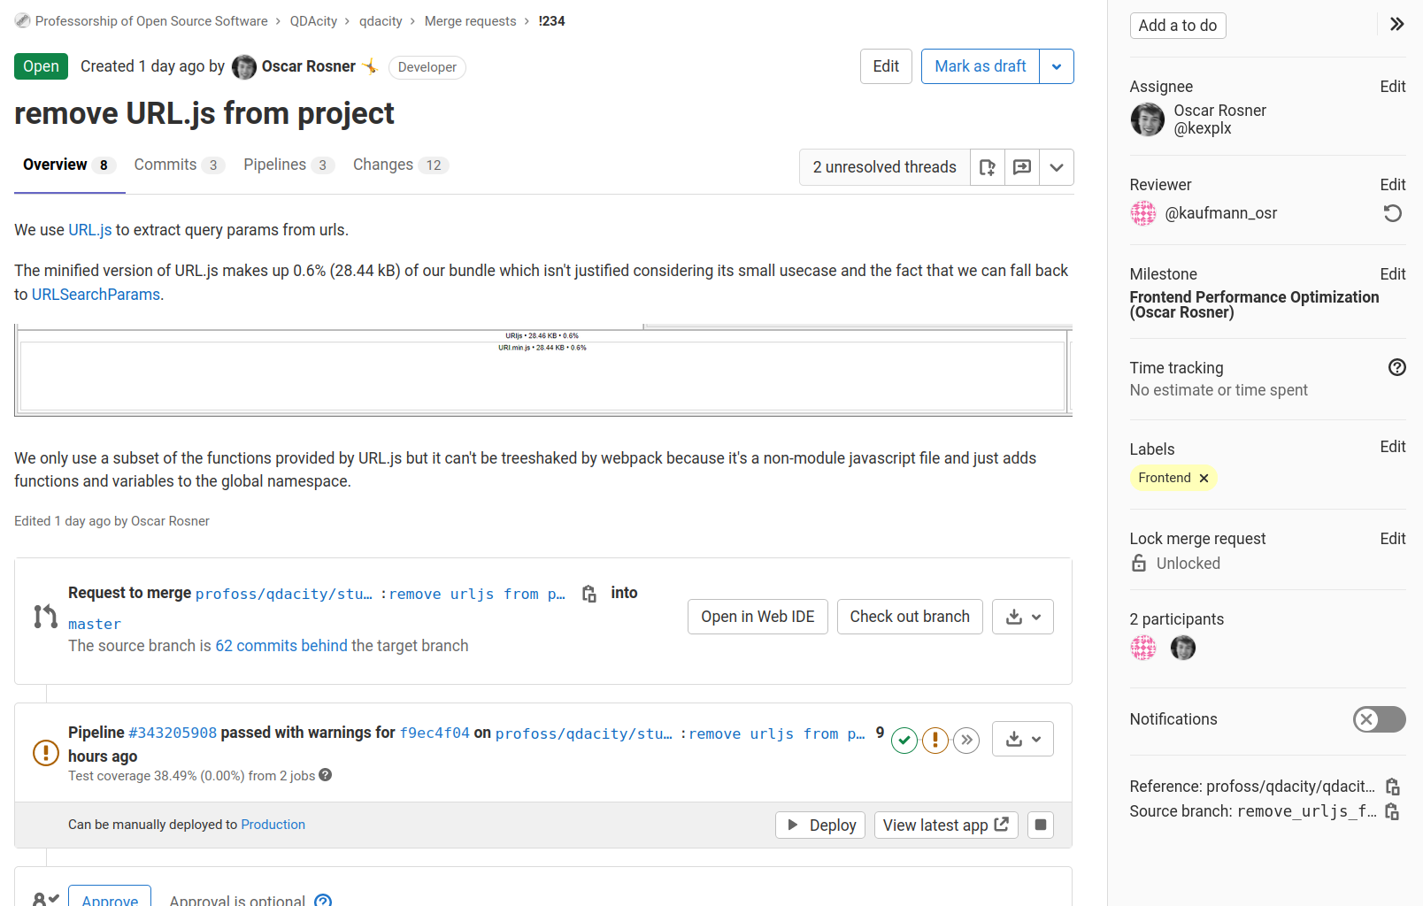
Threaded Discussions

Slide 21
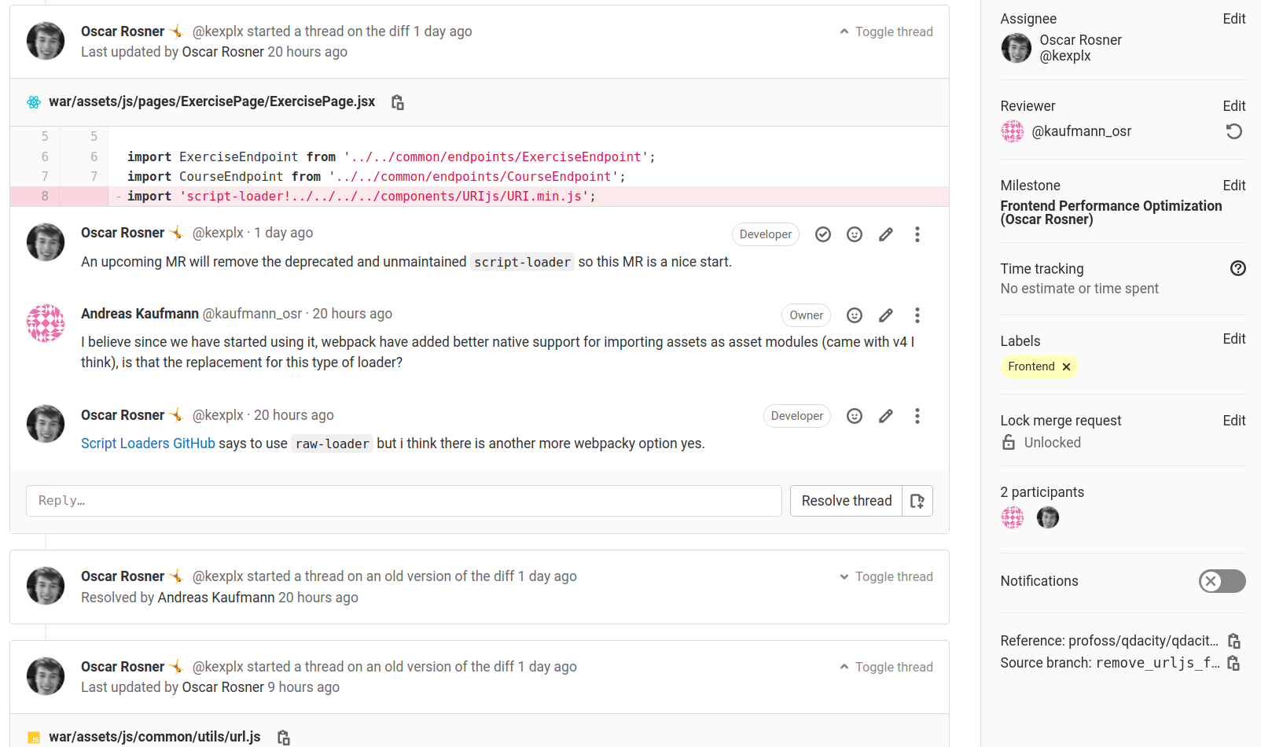
Thread Resolution

Slide 22
Other Considerations
Single (mono) repository vs. many
Main-line vs. feature branches

Slide 23
4. Open Source Strategy

Slide 24
Open Source Community vs. University / Company
(Community)
Open Source
(Single-Vendor)
Open Source
Closed Source
Community
Collaborative
University
Process
(Governance)
Community
University
University
Product
(IP Ownership)
Not differentiating
Reason-to-use
Reason-to-buy
Commercial relevance of features
Commercial relevance of features

Slide 25
Pushing out Features
(Community)
Open Source
(Single-Vendor)
Open Source
Closed Source
Community
Collaborative
University
Process
(Governance)
3
2
1
Community
University
University
Product
(IP Ownership)
Not differentiating
Reason-to-use
Reason-to-buy
Commercial relevance of features
Commercial relevance of features

Slide 26
Pulling in Features
(Community)
Open Source
(Single-Vendor)
Open Source
Closed Source
Community
Collaborative
University
Process
(Governance)
4
5
6
Community
University
University
Product
(IP Ownership)
Not differentiating
Reason-to-use
Reason-to-buy
Commercial relevance of features
Commercial relevance of features

Slide 27
Public Money, Public Code?
Universities have both a non-profit and commercial part
  Universities are tasked with research and teaching, among others
  Universities are also tasked with exploiting their innovations
It is the university’s choice what to give away for free

Slide 28
5. Getting Users

Slide 29
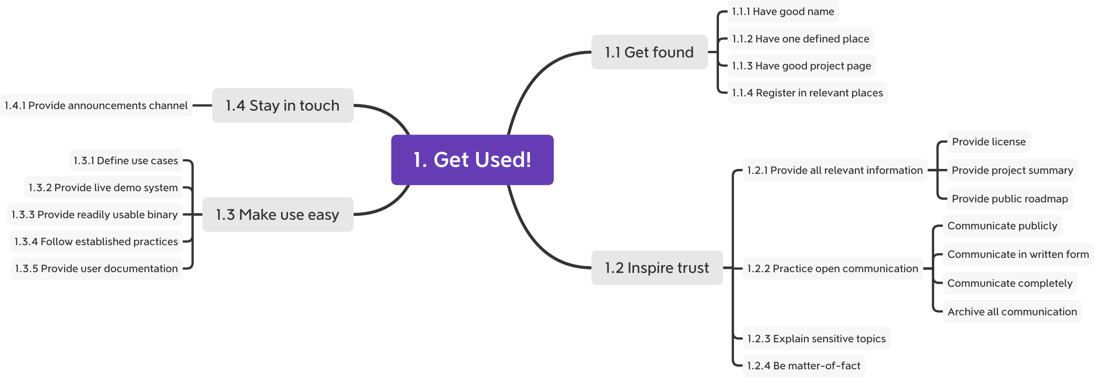
Best Practices for Setting-up Shop and Getting Users [R20]

Slide 30
6. Getting Contributions

Slide 31
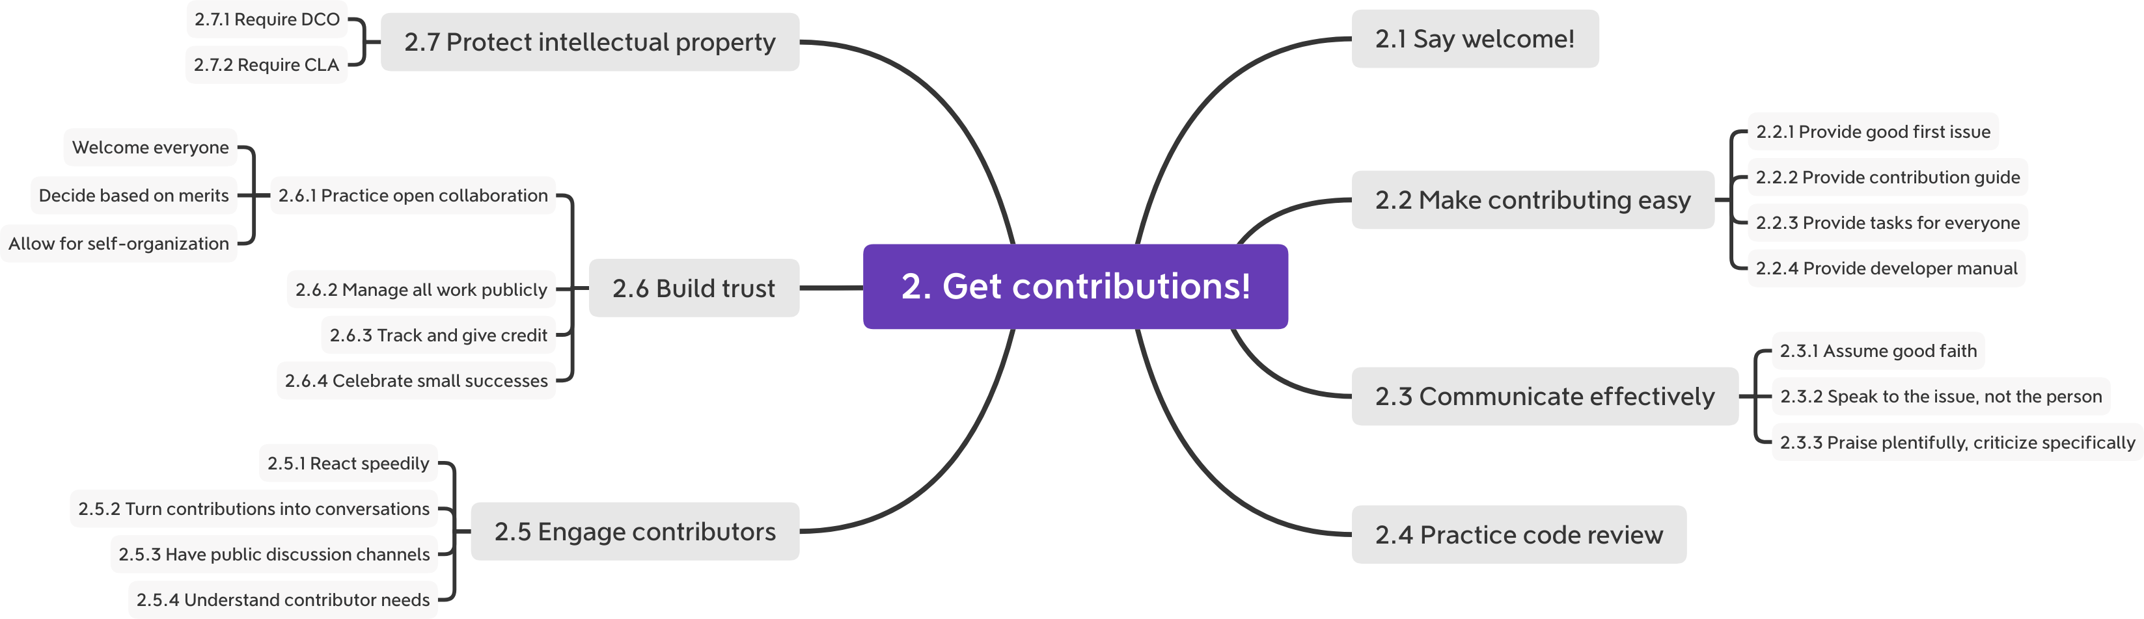
Best Practices for Getting Contributions [R20]

Slide 32
Summary
Research vs. startup
Project management
Lead programming
Open source strategy
Getting users
Getting contributions

Slide 33
Thank you! Questions?
dirk.riehle@fau.de – https://oss.cs.fau.de
dirk@riehle.org – https://dirkriehle.com – @dirkriehle
DR

Slide 34
Legal Notices
Licence
  Licensed under the CC BY 4.0 International license
Copyright
  © 2020-2021 Dirk Riehle, some rights reserved

